Slide 1
How weather conditions during pregnancy and lactation influence young bats development?

Slide 2
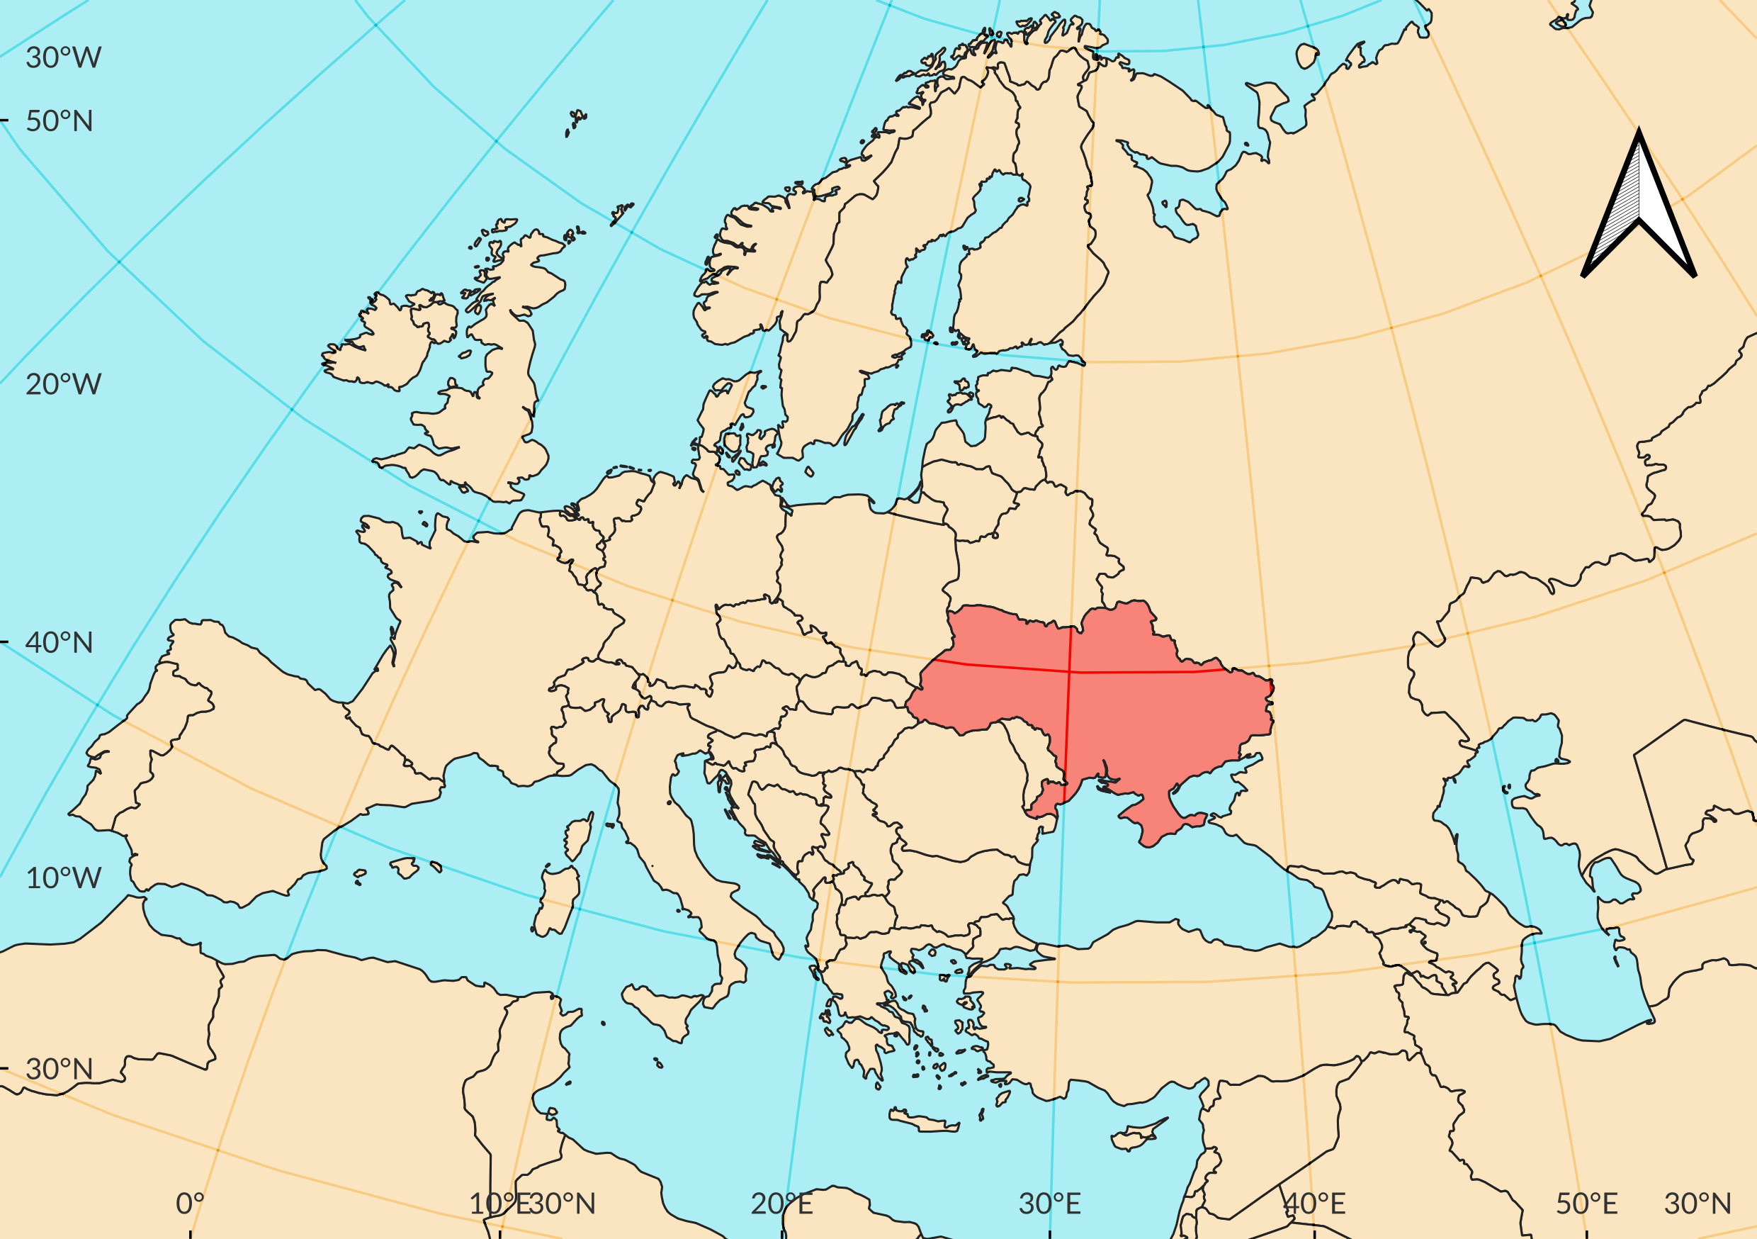
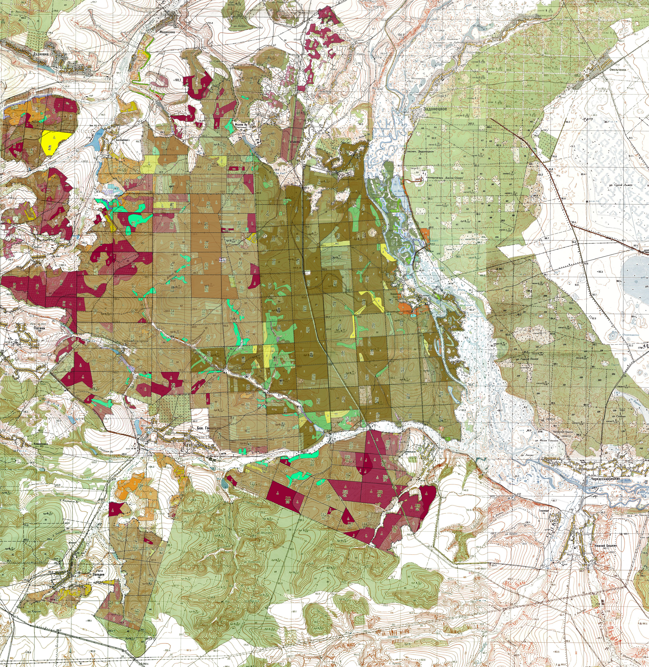
How weather conditions during pregnancy and lactation influence young bats development?
National Nature Park “Homilsha forests”, Kharkiv region, Ukraine mixed broadleaves oak forest

Slide 3


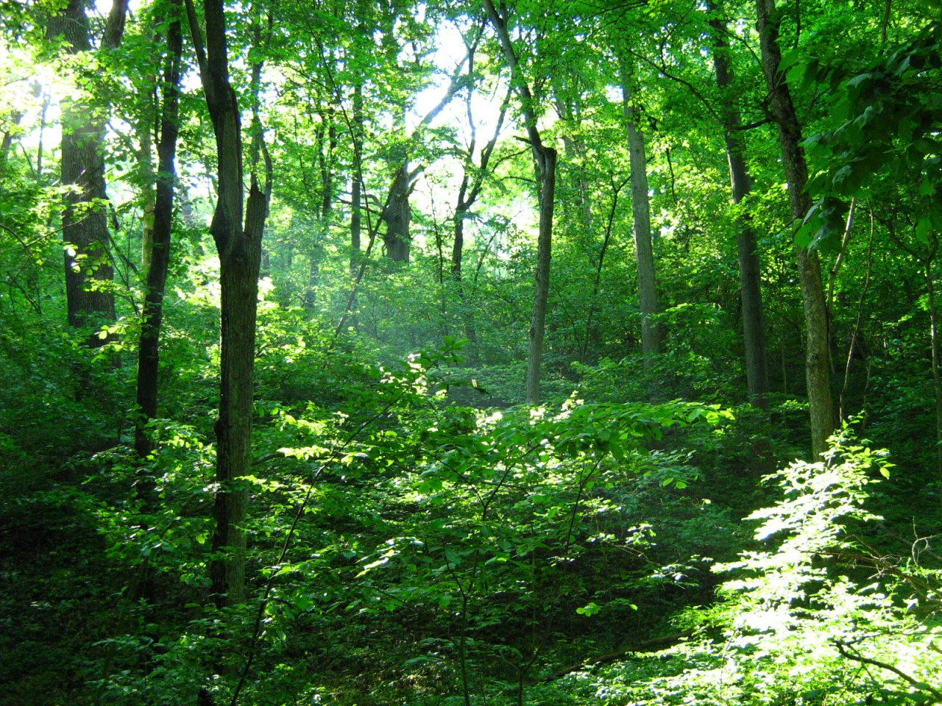

Slide 4
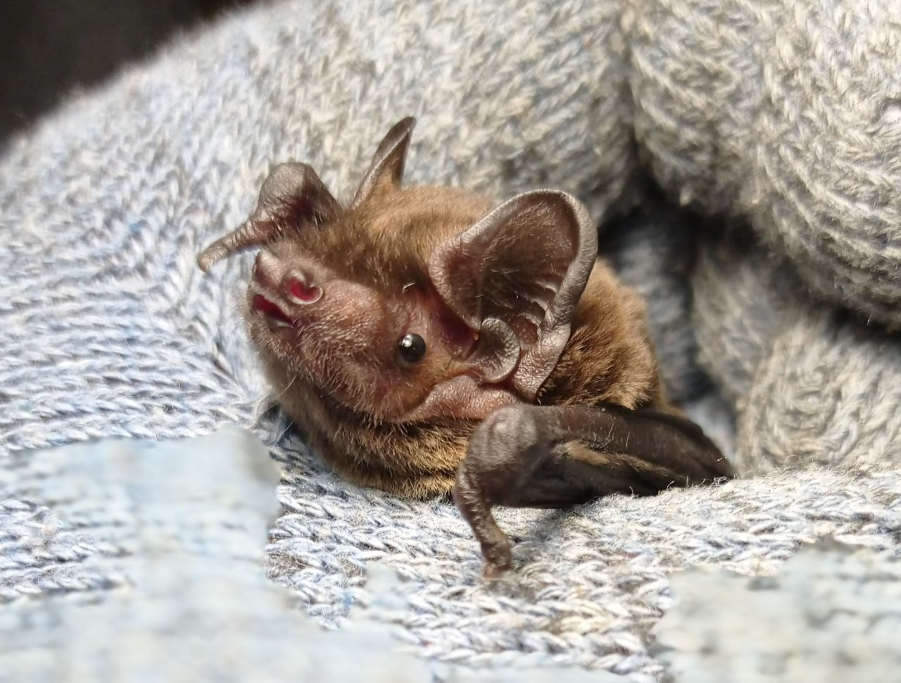
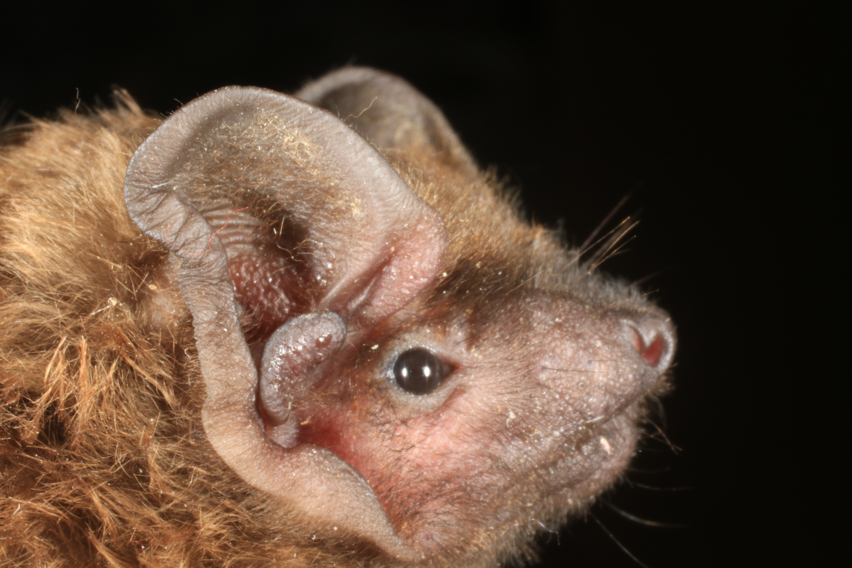
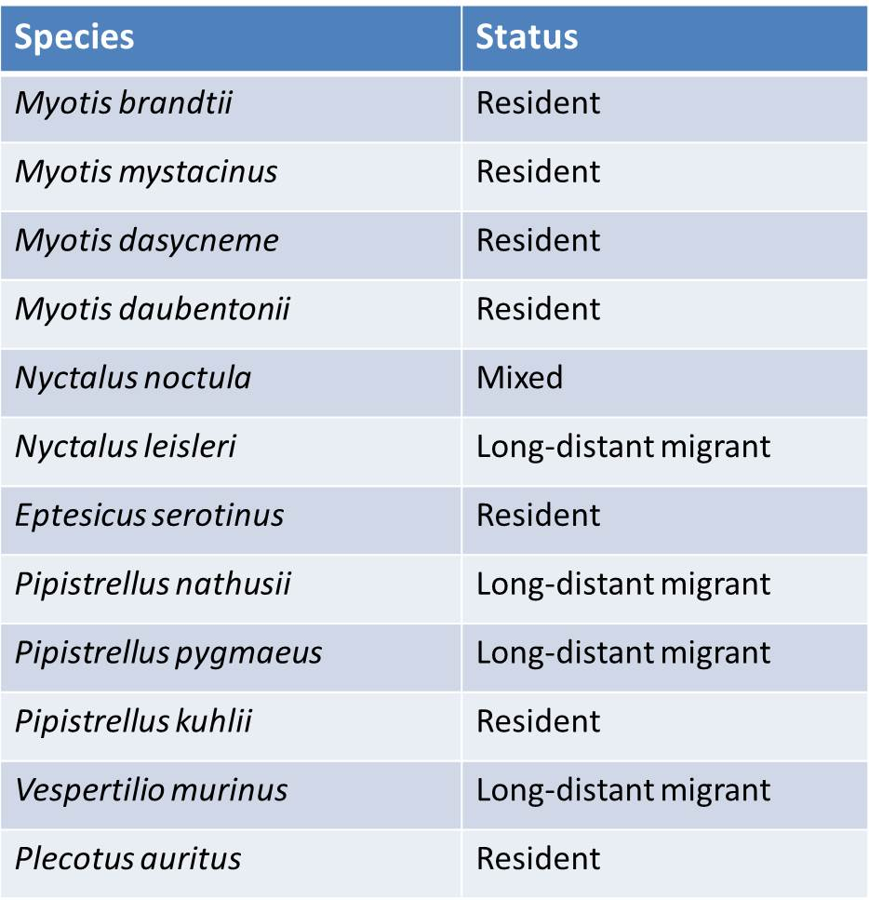
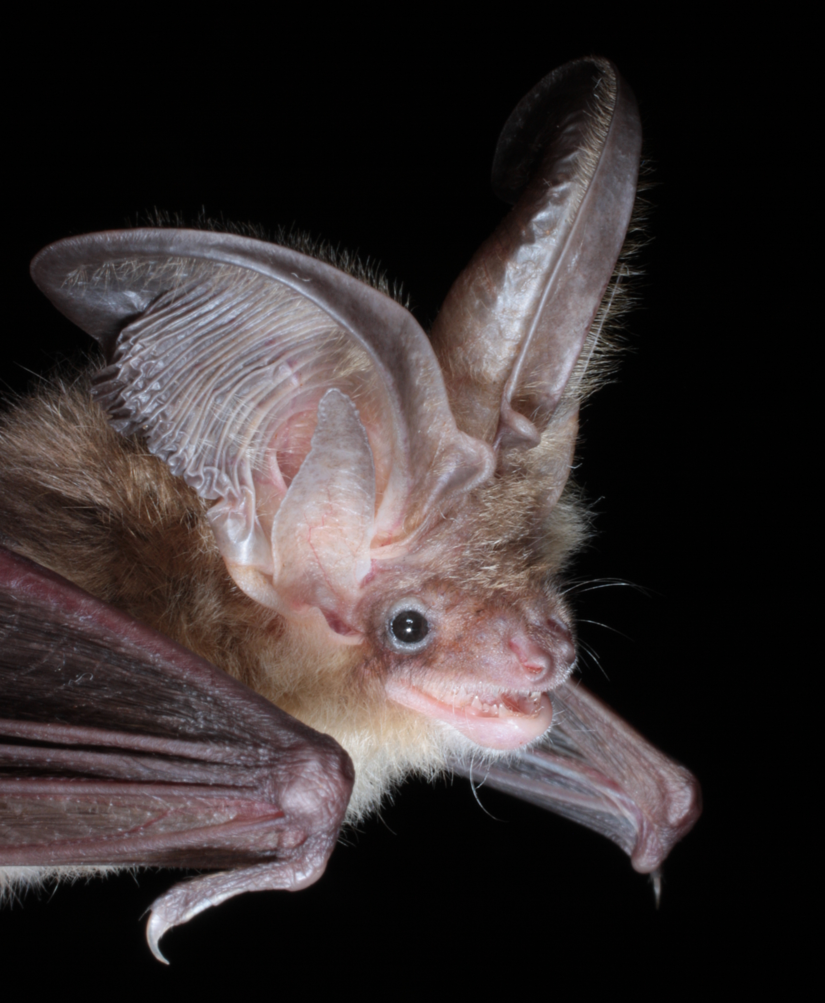
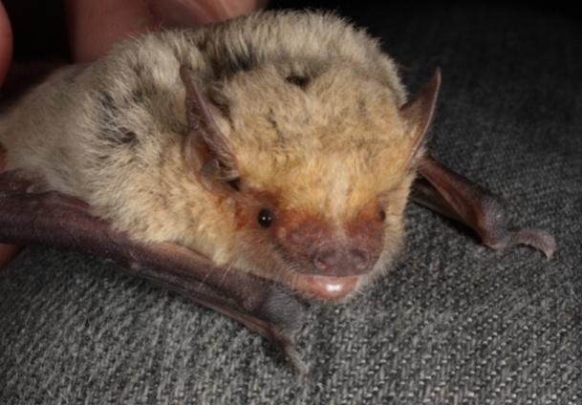
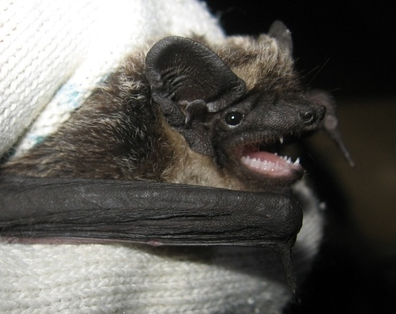
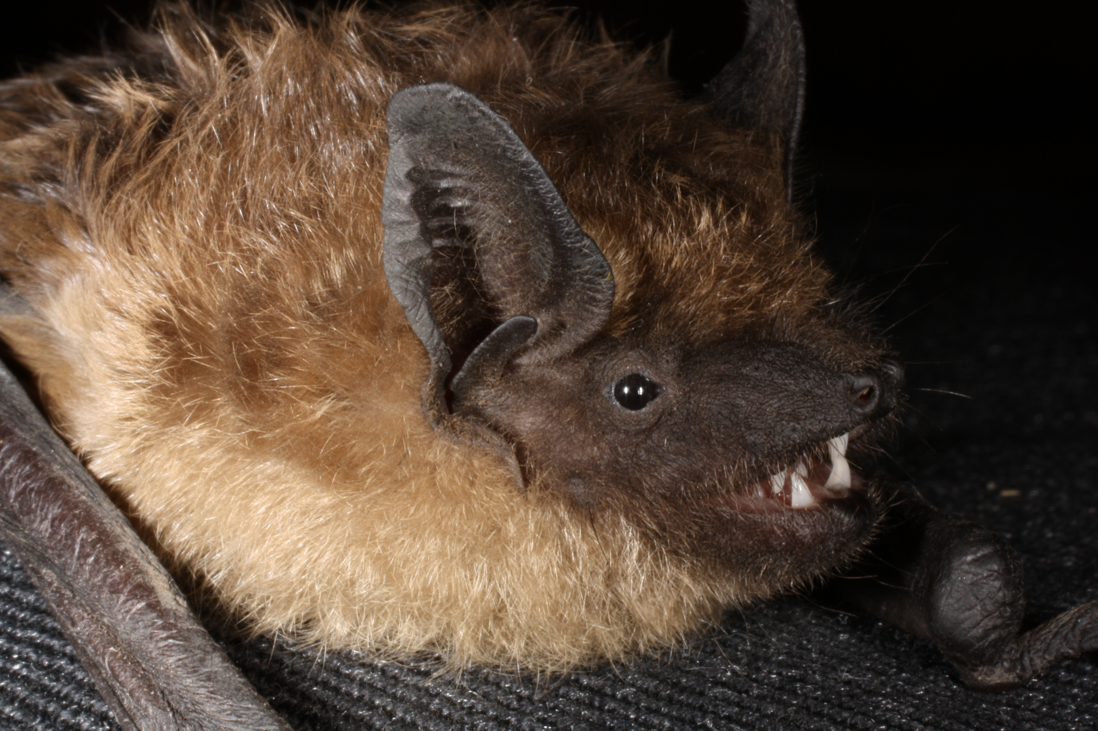
Core breeding area

Slide 5

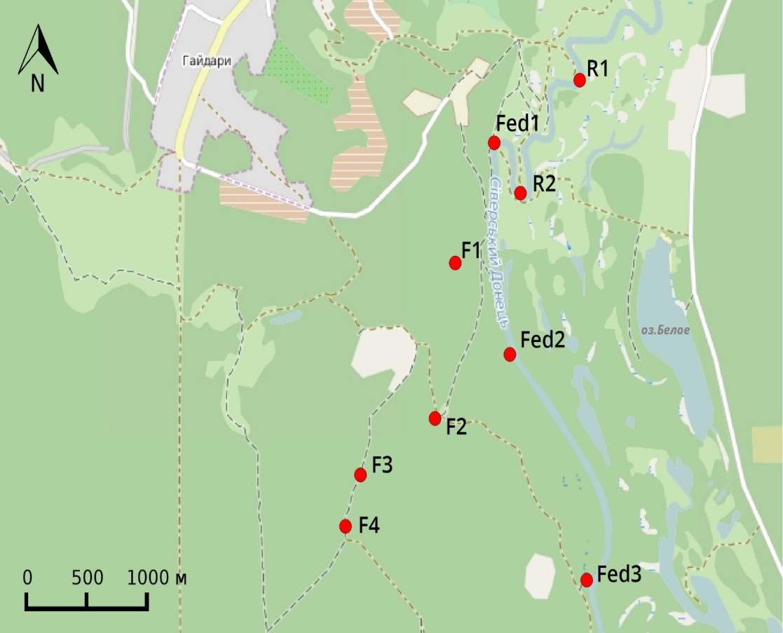
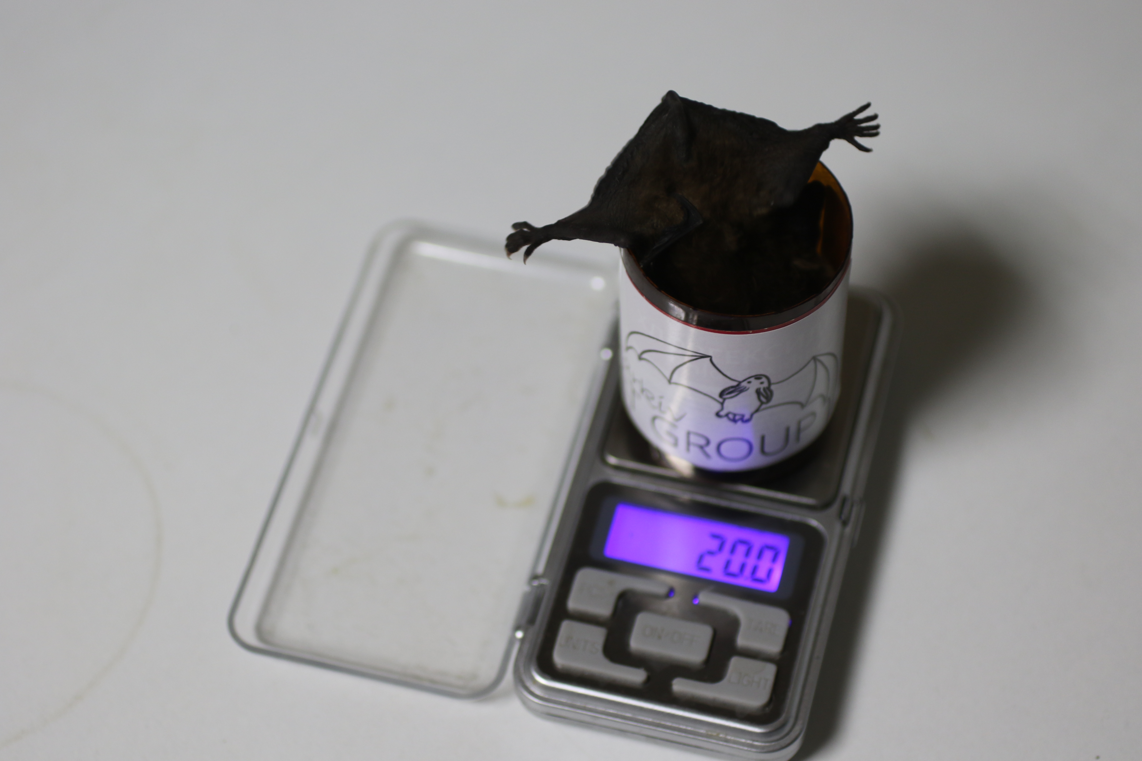
Monitoring system
mist-nets (12 × 3 m length).
from sunset until 10–30 min before sunrise totally 18 capture nights
in July 2008, 2011, 2014, 2019 Body weight measurements were done after 8-10 hours 1698 bats
of 11 species

Slide 6
Research question and predictions
Does temperature (and rainfall) during period of pregnancy and lactation affect growth of young bats? Warmer and drier conditions lead to bigger sizes 2 species, migrant and sedentary
 | Myotis daubentonii | Nyctalus noctula
Body weight | n = 123 | n = 542
Forearm lenght | n = 132 | n = 602

Slide 7
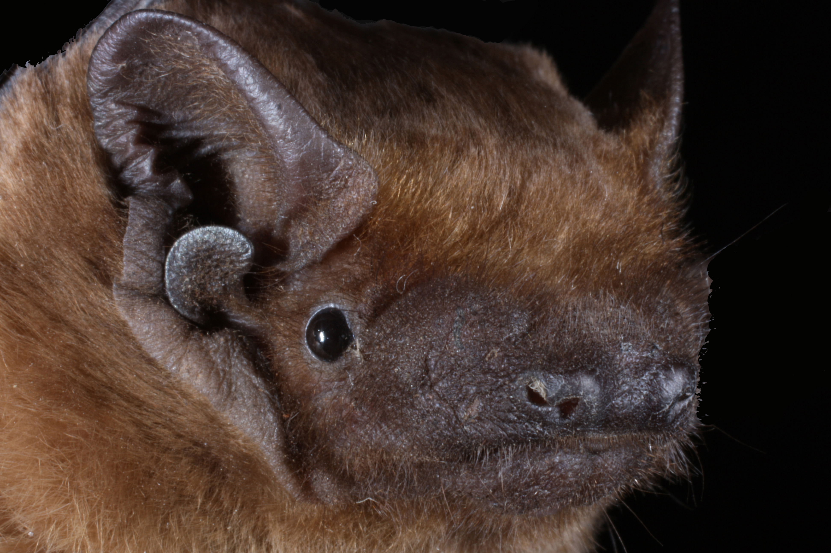
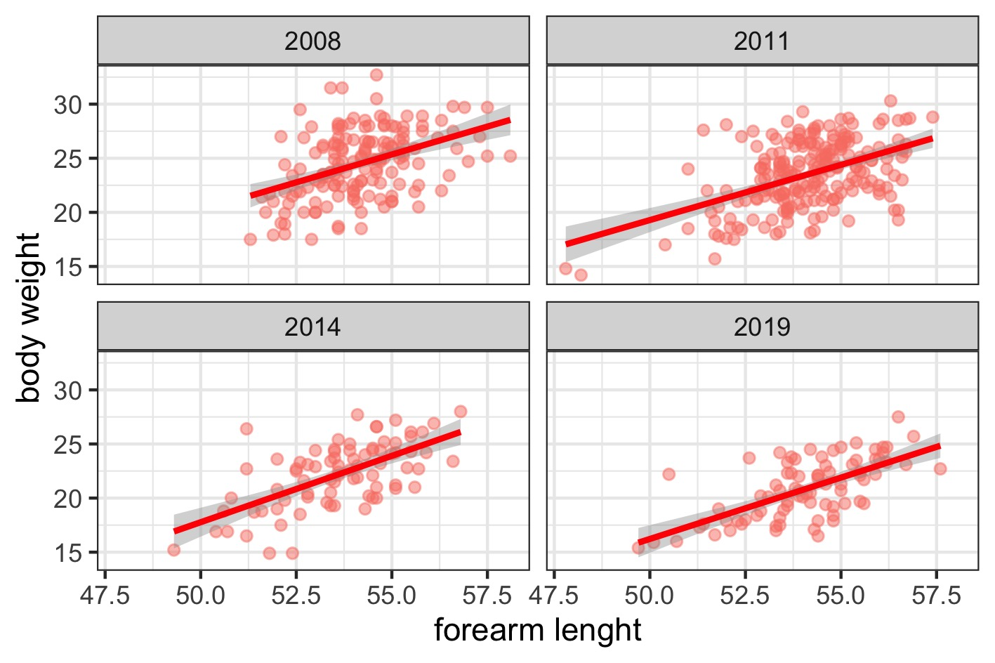
Body conditions of young bats
Nyctalus noctula

Slide 8
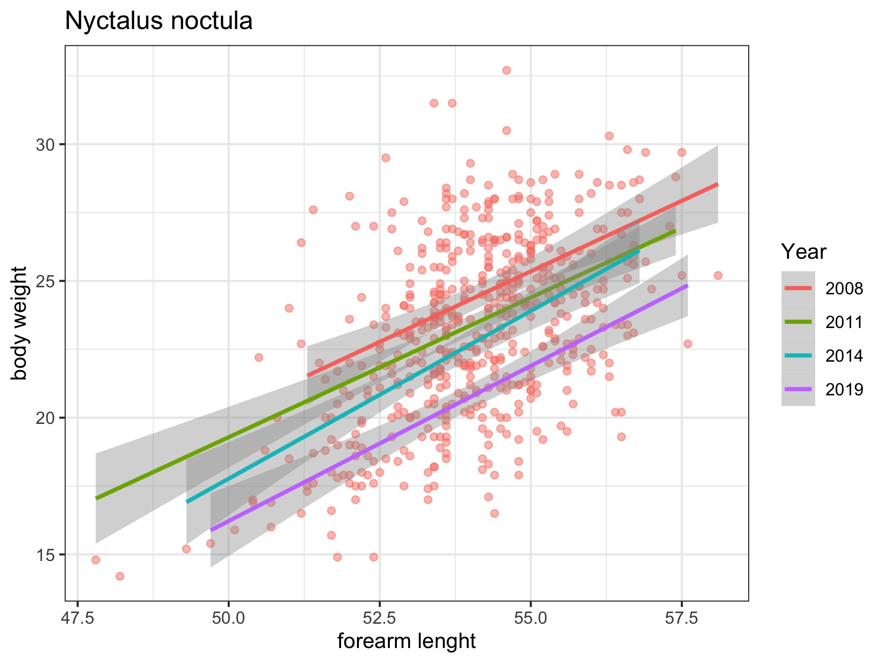
Body conditions
Nyctalus noctula
Notes:
You could potentially tease out foraging as a confounding factor by using time of capture if you have it

Slide 9
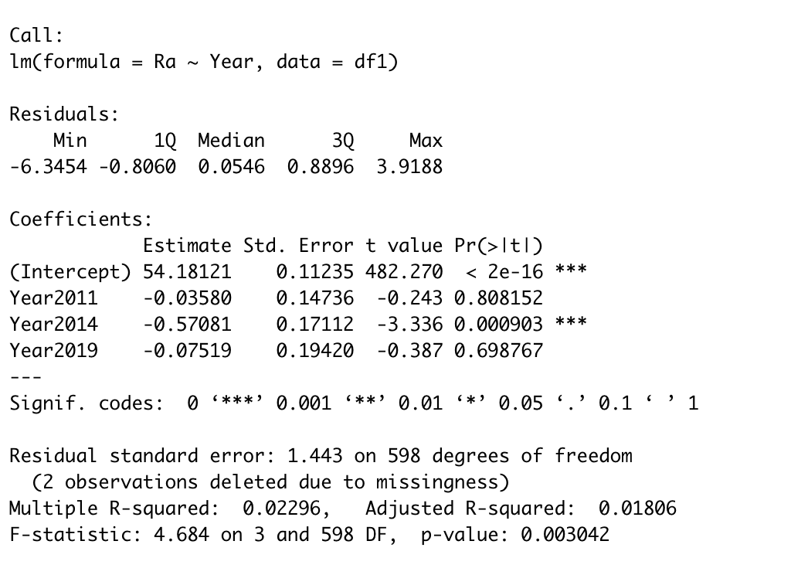
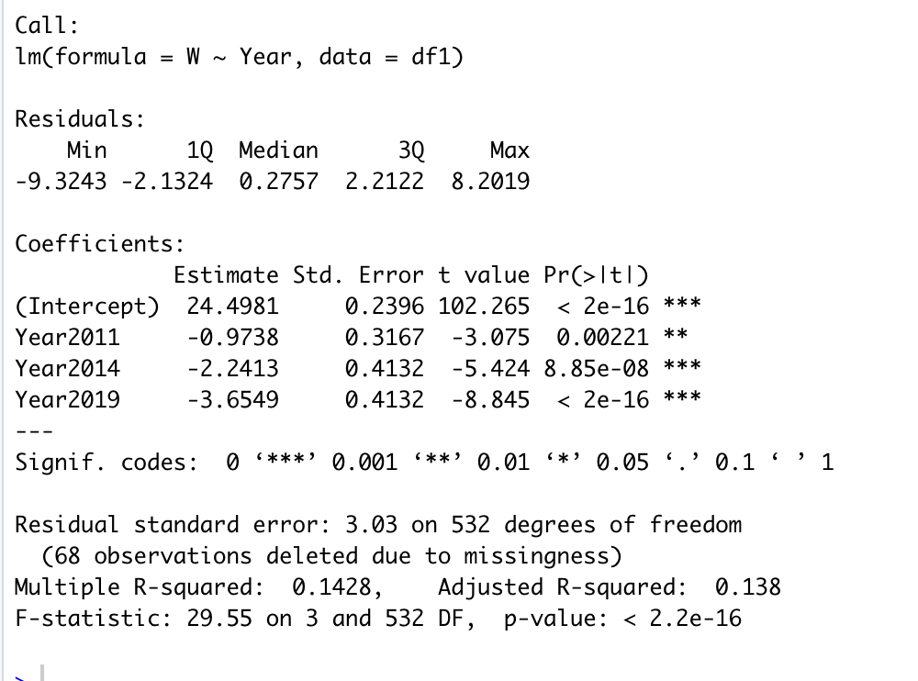
Forearm lenght Weight
N.noctula

Slide 10
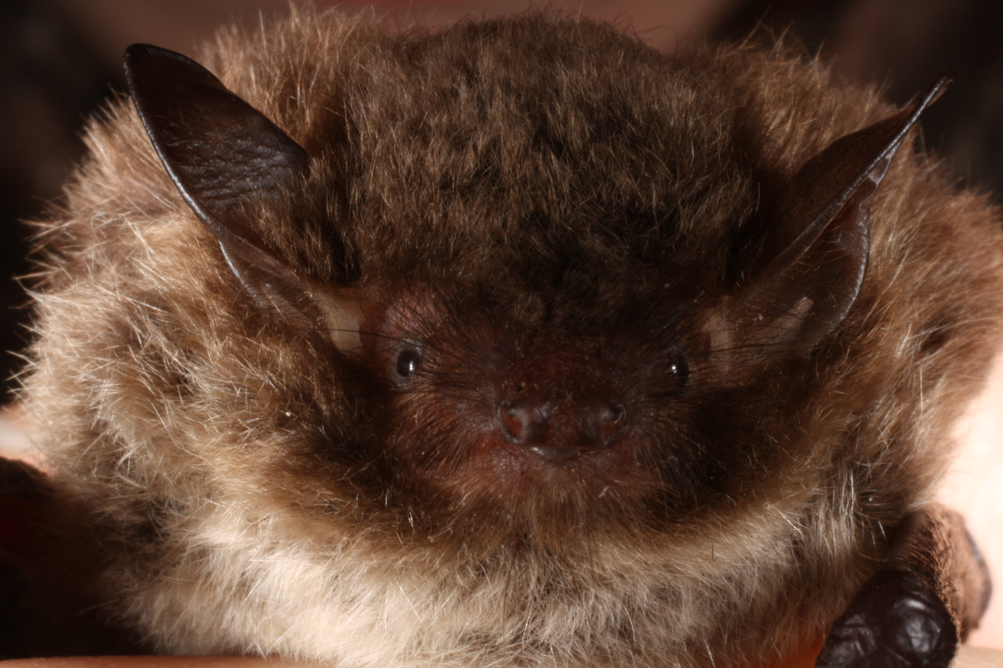
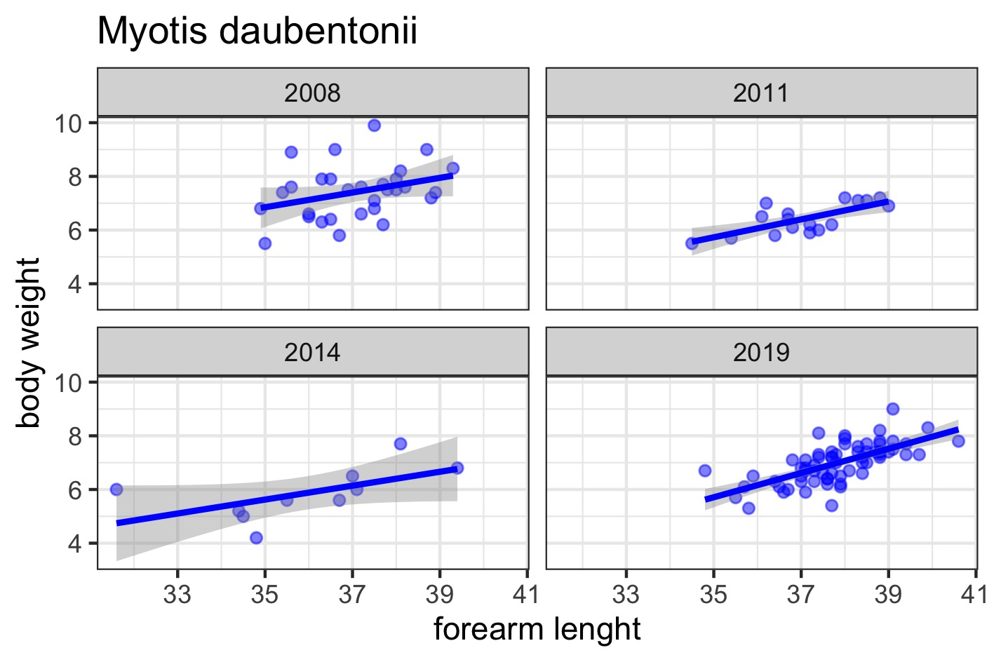
Body conditions of young bat
Myotis daubentonii

Slide 11
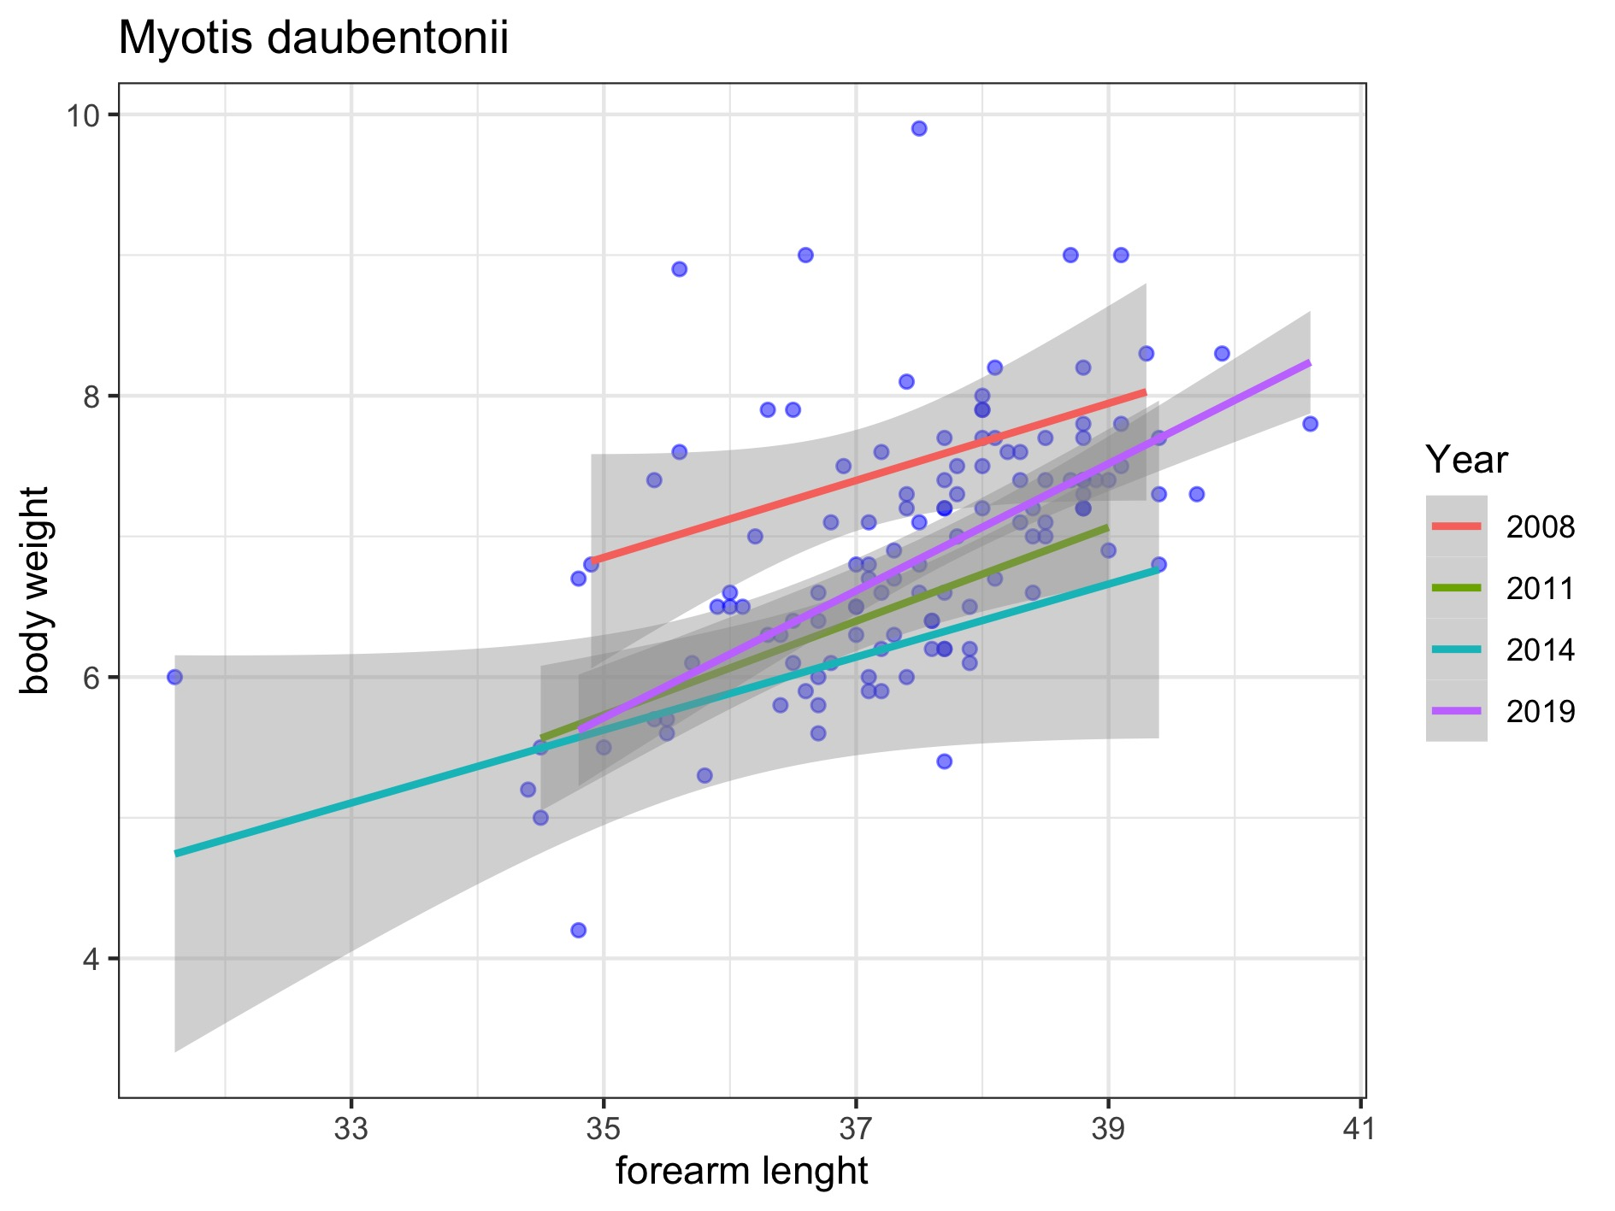
Body conditions
Myotis daubentonii

Slide 12
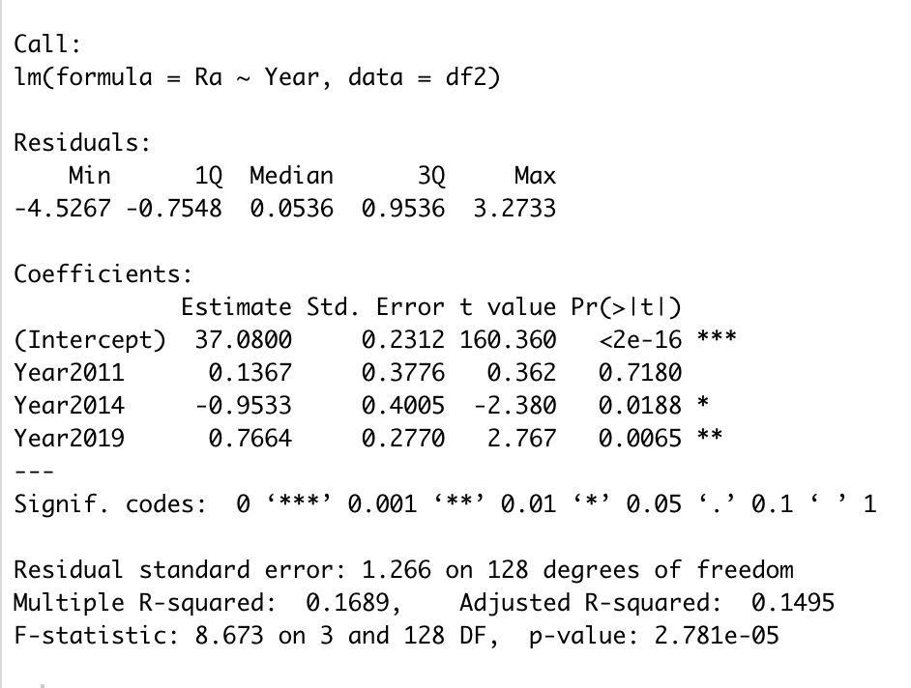
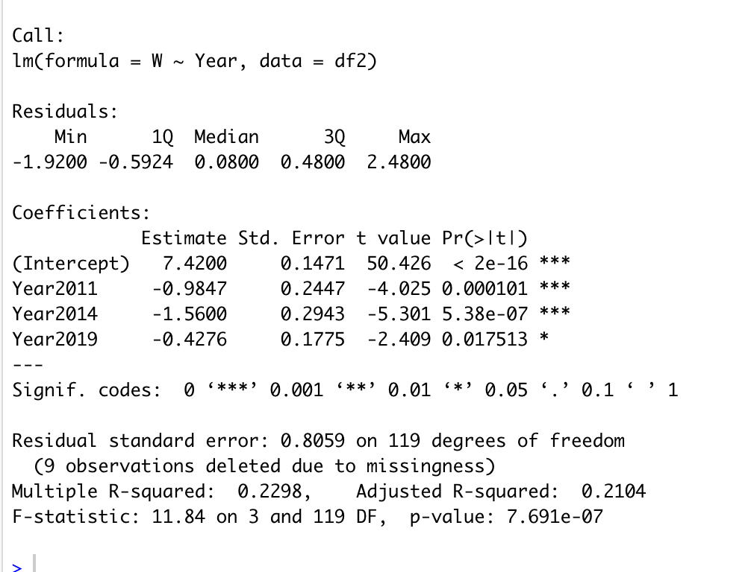
M.daubentonii

Slide 13
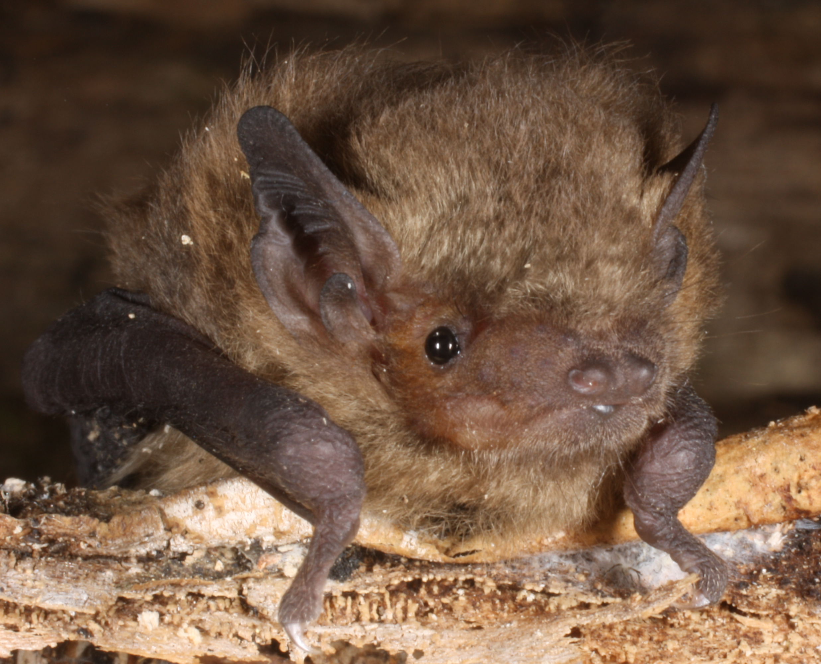
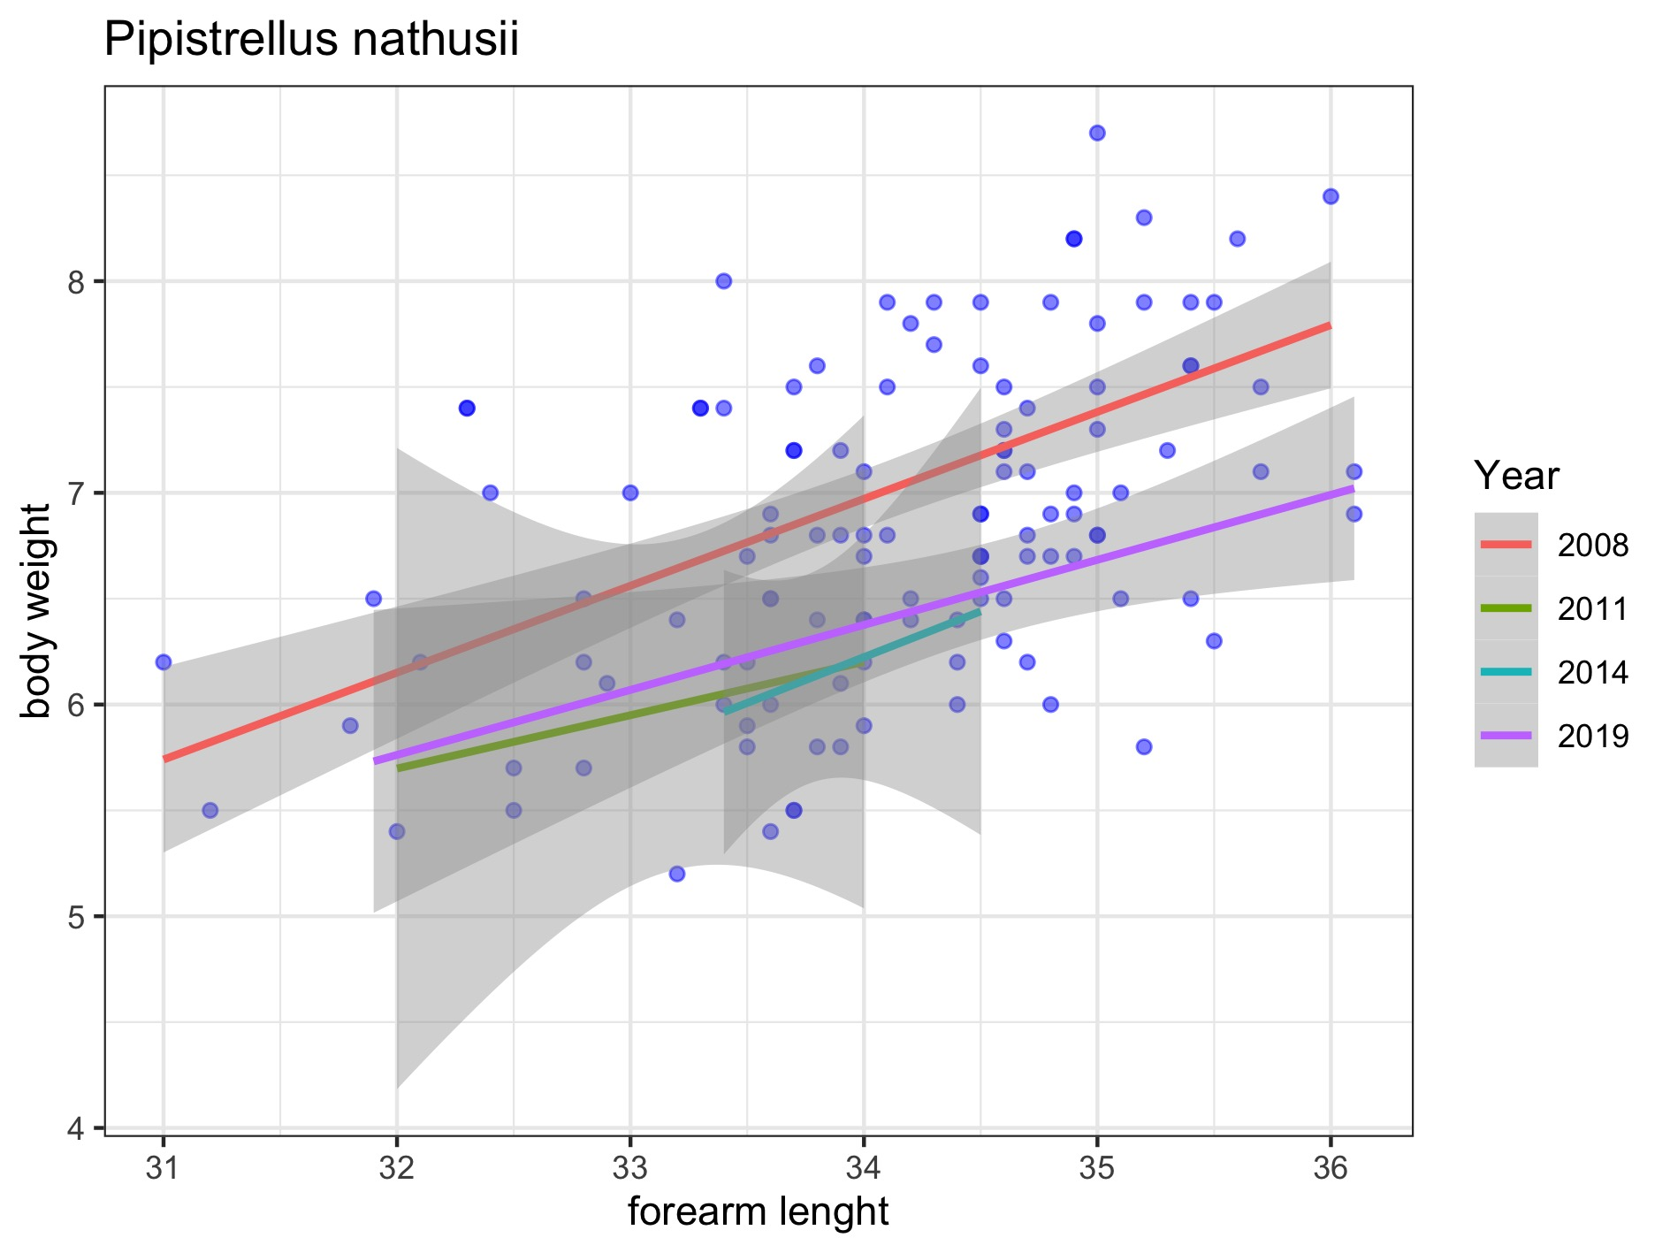
Body conditions
Pipistrellus nathusii

Slide 14
Next steps
Weather factors influence - GDU (growing deegree units) from 1 of March to capture date - rainfall level - number of days with rain

